Slide 1
Operators in Java
Introduction to Java

Slide 2
Operators in java
An operator is a character that represents an action, for example + is an arithmetic operator that represents addition.
Types of Operator in Java
1) Basic Arithmetic Operators 2) Assignment Operators 3) Logical Operators 5) Comparison (relational) operators 6) Bitwise Operators 7) Ternary Operator

Slide 3
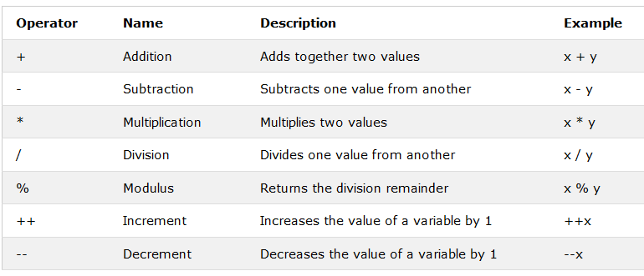
Basic Arithmetic Operators
Arithmetic operators are used to perform common mathematical operations.

Slide 4
Example of Arithmetic Operators
int num1 = 100;
int num2 = 20;
System.out.println("num1 + num2: " + (num1 + num2) );
System.out.println("num1 - num2: " + (num1 - num2) );
System.out.println("num1 * num2: " + (num1 * num2) );
System.out.println("num1 / num2: " + (num1 / num2) );
System.out.println("num1 % num2: " + (num1 % num2) );

Slide 5
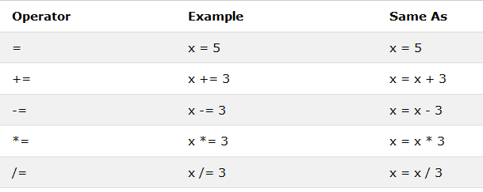
Assignment Operators
Assignments operators in java are: =, +=, -=, *=, /=, %=

Slide 6
Example of Assignment Operators
int num1 = 10;
int num2 = 20;
num2 = num1;
System.out.println("= Output: "+num2);
num2 += num1;
System.out.println("+= Output: "+num2);
num2 -= num1;
System.out.println("-= Output: "+num2);

Slide 7
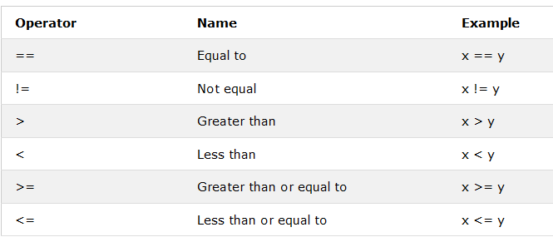
Comparison/Relational Operators
Comparison operators are used to compare two values:

Slide 8
Example relational operators
int x = 5;
int y = 3;
System.out.println(x == y);
//returns false because 5 is not equal to 3
int x = 5;
int y = 3;
System.out.println(x > y);
//returns true because 5 is greater than 3

Slide 9
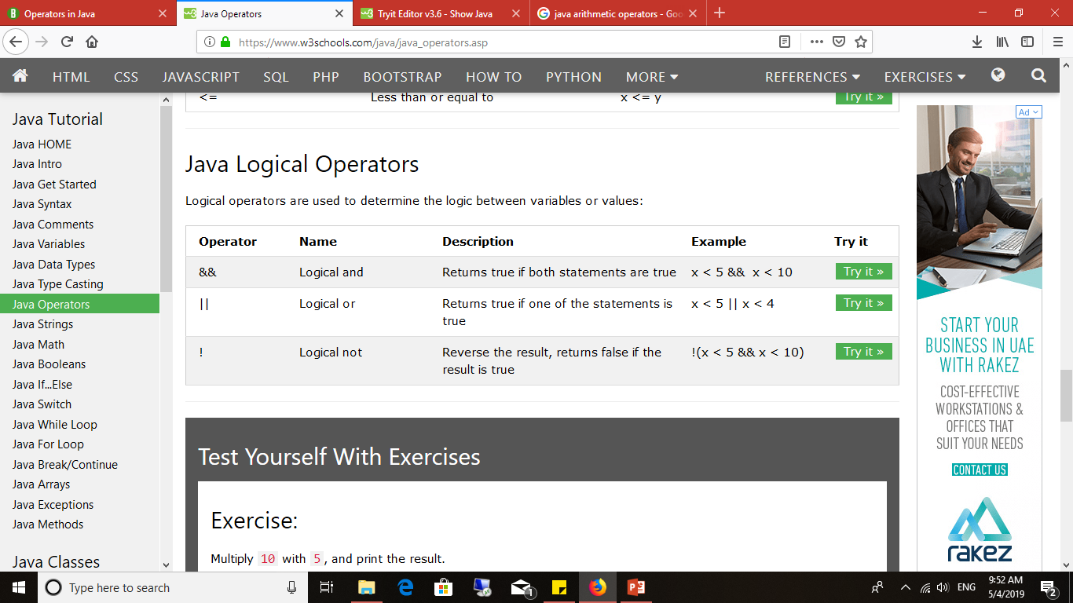
Logical operators
Logical operators are used to determine the logic between variables or values:

